Slide 1
employABILITY Skills: Soft vs. Hard Skills Lesson

Slide 2
Goals for this Lesson
Consider the skills you possess for your future career journey
Understand
the difference between hard & soft skills
the important role soft skills play in the workplace
Set goals for improving your skills
Consider how to communicate your skills to an employer

Slide 3
Saskatchewan Perspective
The Credit Counselling Society released a report in January [2018] showing there has been an increase of people under 35 years old [seeking] help to deal with unemployment since 2010. (CBC)

Slide 4
Vision of your Future!
Choose
Choose an interesting occupation that you would like to have when you are older.
Write down
Write down your choice
List
List five skills that an employer would expect from you if you were to be hired for this occupation.

Slide 5
Hard Skills
Hard Skills are directly relevant to the job to which you are applying. These are often more obvious, observable, and easier to learn than soft skills.
A hard skill for a carpenter, for example, might be the ability to operate a power saw or use framing squares.
https://www.thebalancecareers.com/list-of-soft-skills-2063770#what-are-soft-skills

Slide 6
Soft Skills vs. Hard Skills
Soft skills are the personal qualities, personality traits, built-in social cues, and communication abilities needed for success on the job.
Soft skills define how a person interacts in his or her relationships with others, and they are present when people are faced with individual tasks and challenges.
Unlike hard skills that are learned, soft skills are similar to emotions or insights that allow people to “read” others. These are much harder to learn, measure, and evaluate.

Slide 7
B. Personal Soft Skills
Read the Soft Skills list and put a check mark beside the soft skills that you believe you possess.
Circle the skills you don’t feel you possess…yet.

Slide 8
C. Hard Skills vs. Soft Skills
-Provide examples of hard skills.
-Write a definition of soft skills in your own words.
Identify the hard and soft skills that you listed when you imagined an occupation for your future.

Slide 9
D. Soft Skills are Valued!
Many employers in Saskatchewan value soft skills over hard skills when hiring new employees. Why do you think this is the case?
List three possible explanations.

Slide 10
Did you consider?
Employers value people who are organized, hard working, polite to others, and demonstrate a willingness to learn.
These soft skills are harder to teach since they involve a change in habits and behaviour.
Depending on the role, hard skills can be taught relatively easily to those who are eager to learn!

Slide 11
Proof!
Many people assume that hard skills are most important when applying for a job, but:
“85% of job success comes from having well-developed soft skills and people skills, and only 15% of job success comes from technical skills and knowledge (hard skills).” -Harvard University, Carnegie Foundation, and Stanford Research Center

Slide 12
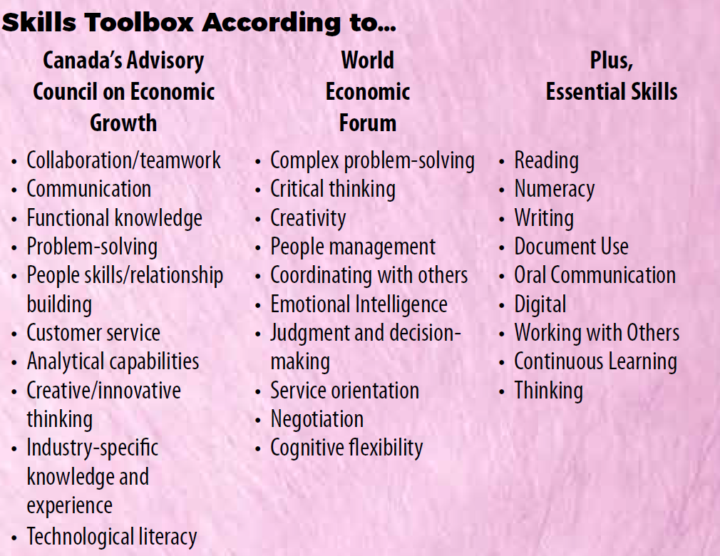
Relevance Magazine www.contact360.ca/relevance/
Most valued soft skills

Slide 13
Consider
How do you think people become aware of the soft skills that they possess?

Slide 14
E. Personal Skill Inventory:
Refer back to the Soft Skill list
Look back at your list of soft skill strength and weaknesses.
Choose one skill that you believe you could turn from a weakness into a strength.
Consider:
How could you turn a weakness into a strength? This is an opportunity to use a Growth Mindset!

Slide 15
Growth Mindset

Slide 16
Growth Mindset Phrases

Slide 17
F. Sell your strengths
Consider the occupation you listed at the start of the session
If you were applying for this occupation, how would you effectively communicate your best hard and soft skills to your potential employer?

Slide 18
Always consider:
Soft & Hard skills are things you can develop, if you choose to put effort into it.
As we gain experience in school, at work, and in public, we build our soft skills.
You never know where your career path may lead, so being open to new challenges and developing skills along the way will benefit you in the future, even if it doesn’t seem to in the present.

Slide 19
Any questions?
Please contact the SIEC if you have questions!
www.saskatooniec.ca
www.contact360.ca

